Slide 1


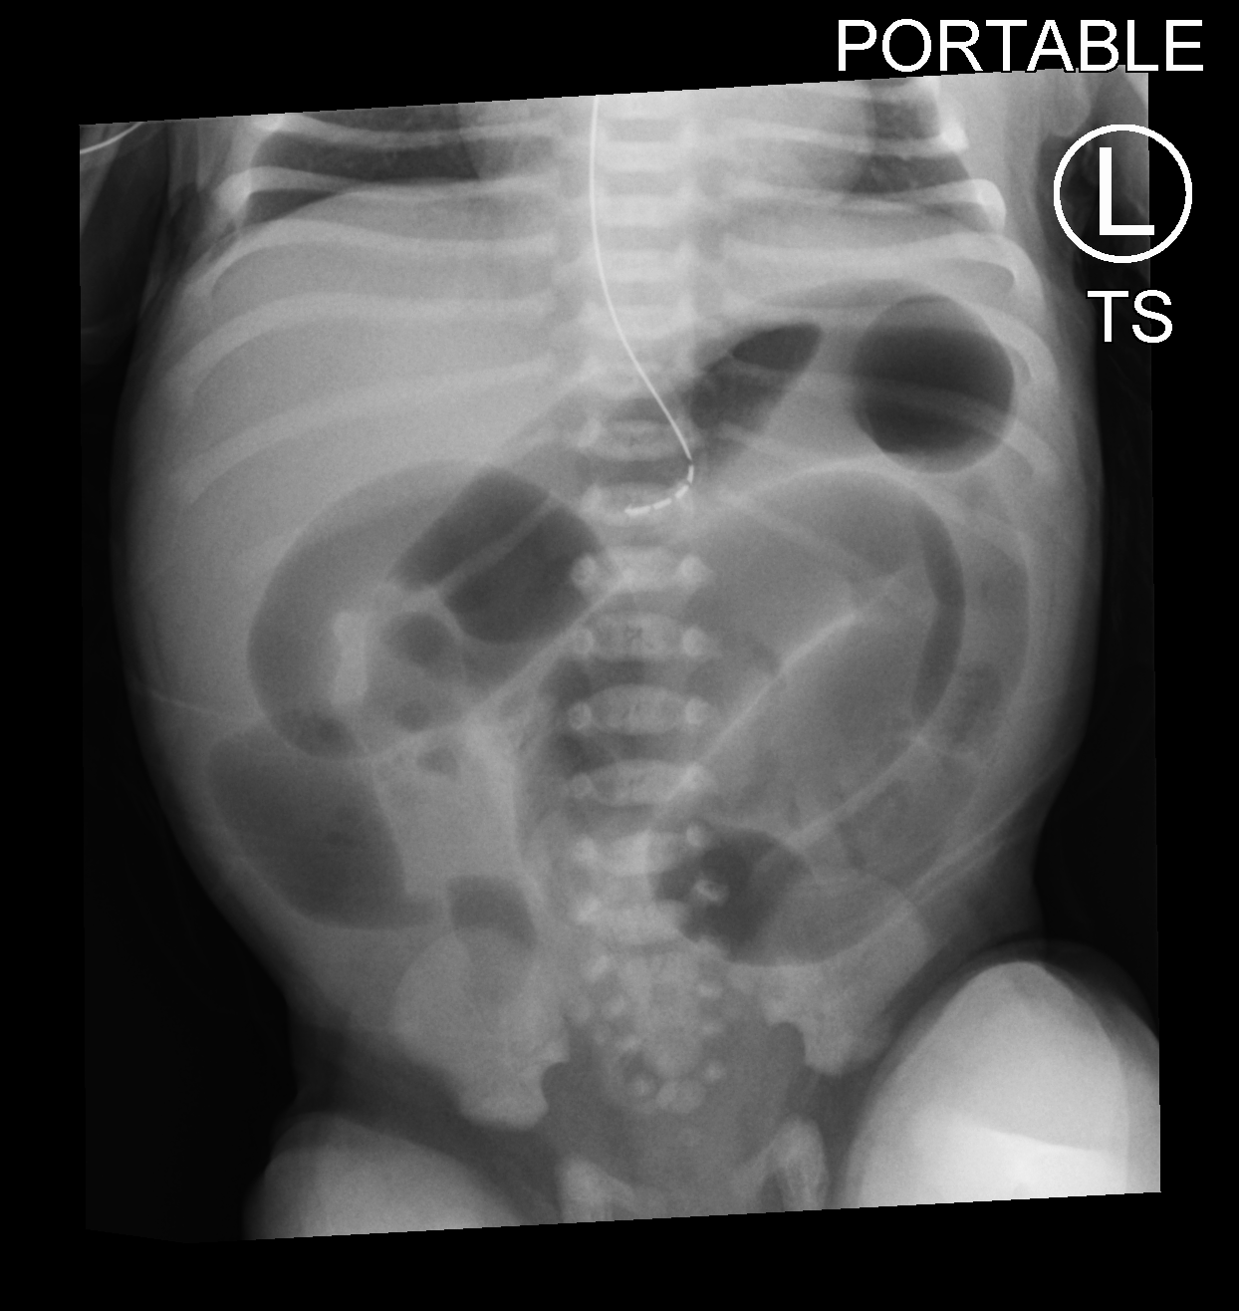
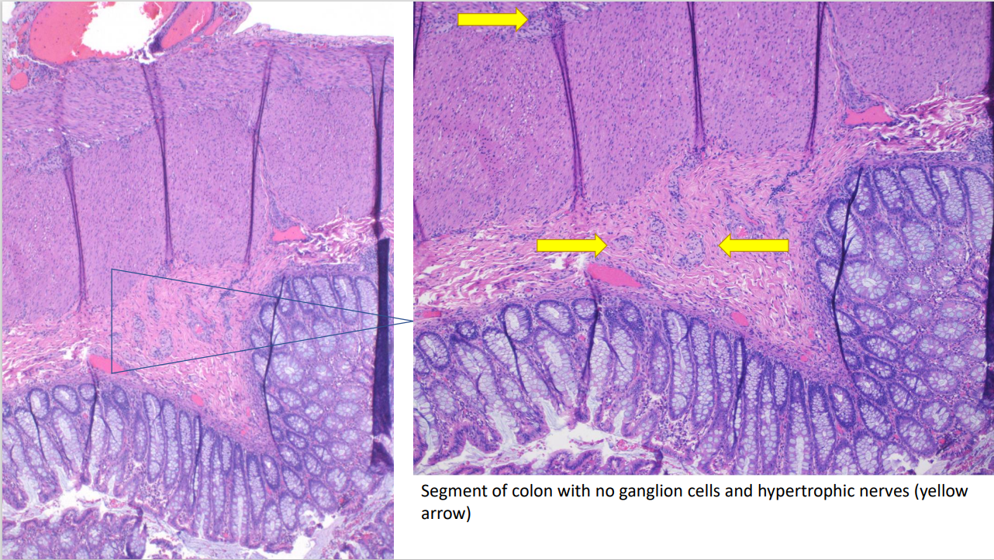
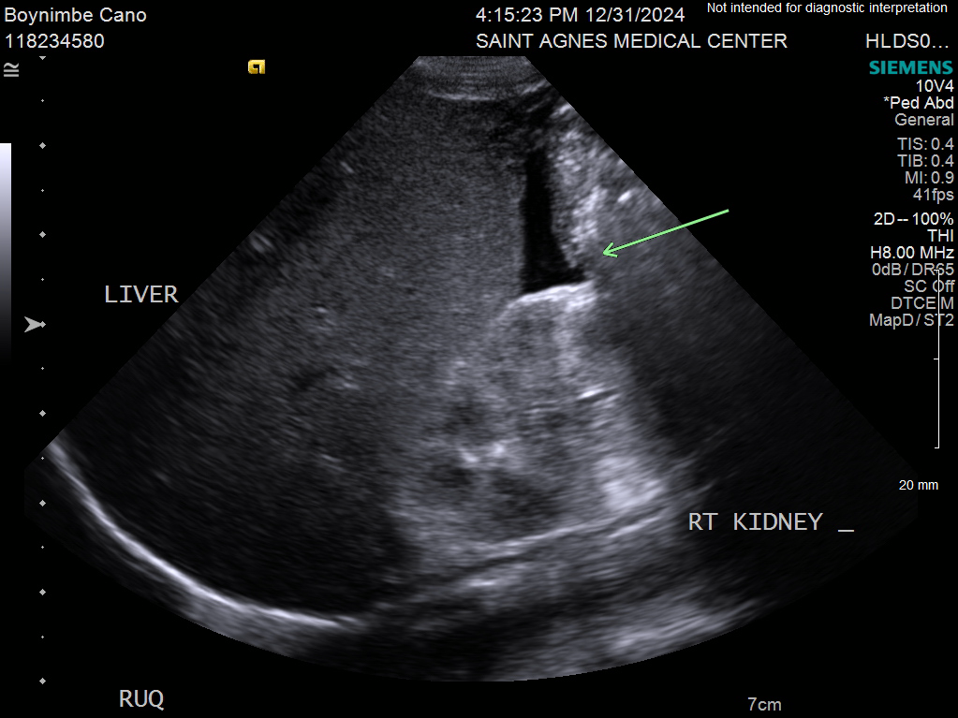
Diagnostic Challenge in Neonatal Vomiting: Case Report
Phillip Kim MD¹, MPH, Donghui Park MD¹, Shelby Wong DO¹,
Cristo Salazar MD², Pulak Agrawal MD²
¹St. Agnes Medical Center Department of Family Medicine, ²Valley Children's Hospital
Introduction
Case Presentation
Discussion
Neonatal bowel obstruction presents with different symptoms, including constipation, nausea, vomiting, irritability, and feeding intolerance. As the etiology is diverse, ranging from benign conditions, such as meconium ileus, to emergent conditions that require surgical intervention such as midgut volvulus with malrotation, Hirschsprung disease, timely imaging is crucial for early diagnosis and treatment.
Hirschsprung disease(HD) is a condition that is caused by absence of ganglion cells in the Auerbach’s and Meissner’s plexus of terminal rectum, which leads to constipation and intestinal obstruction. Diagnosis of HD is confirmed by rectal biopsy, which typically shows absence of ganglion cells in submucosa and muscularis of terminal rectum.
In this case report, the neonate, born to a mother with antenatal microcytic anemia, had a small bowel obstruction. Further workup confirmed Hirschsprung disease. Association of Antenatal conditions with neonatal bowel obstruction, importance of early imaging will be discussed in this case report.
A full-term male neonate, born via normal spontaneous vaginal delivery to a 27-year-old mother with antenatal microcytic anemia, presented at 24 hours of life with bilious vomiting and an inability to pass stool. The mother's pregnancy was otherwise unremarkable, with a normal NIPT screen, though she did develop microcytic anemia in the 2nd trimester, without obvious blood loss or malabsorption. Initial Apgar scores were 8 and 9 at 1 and 5 minutes, respectively. Physical examination revealed a distended abdomen and decreased bowel sounds.
Bowel sounds were present until 1600 of Day 1, and abdominal ultrasound (Figure 1) was performed to rule out midgut volvulus with malrotation. Imaging showed nonspecific ascites, the whirlpool sign was absent. No bowel sounds heard when examined bedside at 1700, NICU was consulted. An NG tube was placed to decompress the bowel, and subsequent Abdominal X-ray (Figure 2) showed dilated small bowel loops. The newborn was transferred to the NICU of Valley Children’s Hospital for further workup and possible surgical intervention.
Neonatal bowel obstruction encompasses a spectrum of pathologies, and imaging findings vary depending on the location of the obstruction, from proximal to distal bowel [1]. Delayed or missed diagnosis of neonatal bowel obstruction can significantly impair the patient's quality of life; therefore, timely imaging and informed decision-making based on the results are crucial [2]. In neonates, the characteristic bowel obstruction patterns may be atypical due to the time required for gas to traverse the intestinal tract, and definitive studies such as barium enemas may be necessary [3].
In the presented case, initial imaging revealed diffuse bowel dilatation, which was initially interpreted as being consistent with small bowel atresia. However, the absence of a whirlpool sign on abdominal ultrasound diminished the suspicion for midgut volvulus [4]. Ascites can be observed antenatally in small bowel atresias. Polyhydramnios, intrauterine volvulus, and other abnormal antenatal ultrasound findings were not observed in the mother of this neonate, which also contributes to diagnostic confusion.
Ultimately, this neonate was diagnosed with Hirschsprung's disease (HD), for which appropriate surgical intervention was successfully performed [6]. Ganglion cells were present in the proximal segment of the colon, but absent distally, confirming the diagnosis (Figure 3).
The mother's laboratory findings at 24 weeks gestation were indicative of iron deficiency anemia. Her hemoglobin level of 9.9 g/dL (99 g/L), combined with a low MCV, strongly suggests iron deficiency as the underlying cause. While iron deficiency anemia is common during pregnancy, severe or prolonged anemia can have adverse effects on fetal development [8].
Iron is crucial for cell proliferation and differentiation, including the development of the enteric nervous system (ENS) [8]. The ENS, derived from neural crest cells, controls gut motility and function. Maternal iron deficiency might impair neural crest cell migration, proliferation, or differentiation, potentially leading to aganglionosis in the distal colon, the hallmark of Hirschsprung's disease.
Further research is needed to investigate the potential link between maternal iron deficiency anemia and Hirschsprung's disease. Future studies could examine the prevalence of antenatal anemia in mothers of infants with HD, explore the effects of iron deficiency on neural crest cell development in animal models, and investigate the genetic and epigenetic mechanisms underlying this association. Therefore, this may contribute to the overall presentation of this case report. The case suggests a clinical gap in diagnosis and management as well as treatment strategies.
Figure 2. Abdominal X-Ray. Obtained after a NG tube insertion. There is dilatation of the stomach and multiple small bowel loops without definite evidence of significant gas within the colon.
Figure 3. Rectal suction biopsy showing absence of ganglion cells in the distal segment of colon and hypertrophic nerves (yellow arrows)
Figure 1. Abdominal Ultrasound of the Right Upper Quadrant. Targeted sonographic evaluation of the abdomen demonstrates a small amount of ascites

